Slide 1
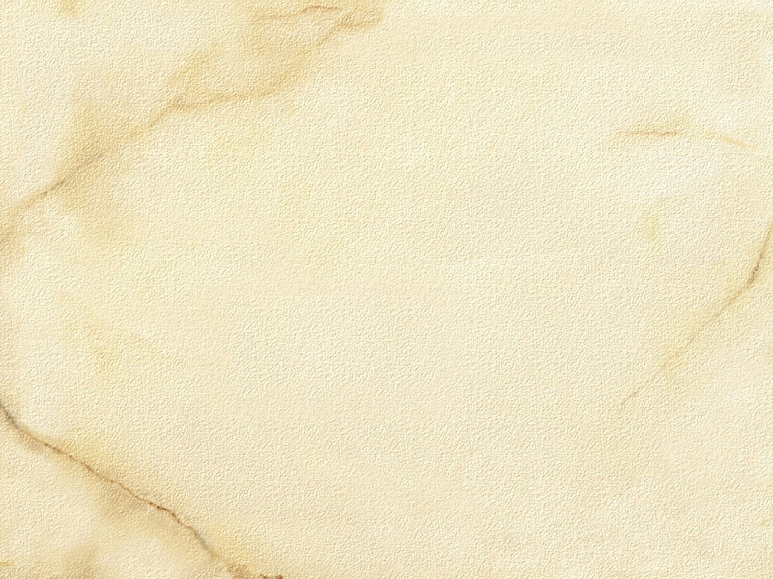
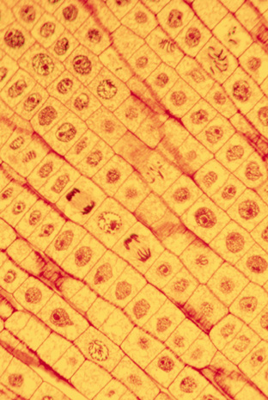
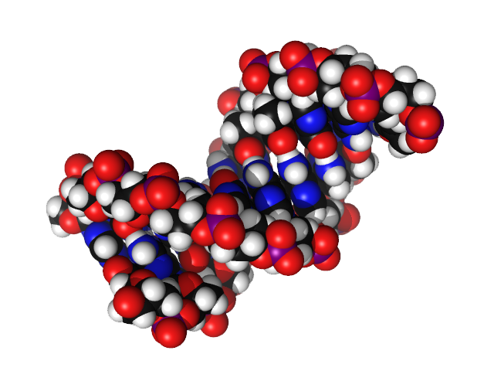

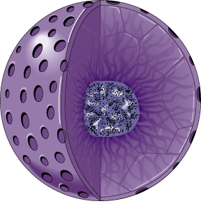

Cell Biology & Biochemistry Series:
Set 6
Version: 1.0

Slide 2
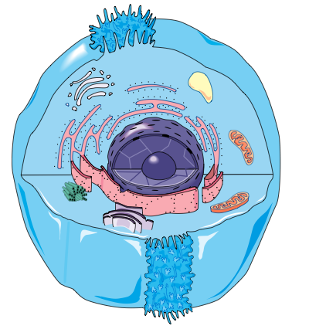
The Cell Nucleus
Eukaryotic cells (plant, animal, fungal, and protistan) are characterized by having a membrane-bound cell nucleus.
The nucleus is a large organelle and contains most of a cell’s genetic material.
The nucleus (right), contains the cell’s genetic material.
Eukaryotic cells, such as the animal cell (above), contain membrane-bound organelles, including a membrane-bound nucleus.
The genetic material of a cell in interphase appears as dark threads

Slide 3

Structure of the Nucleus
The nucleus is usually the largest organelle within the cell.
The nucleus comprises:
  The nucleoplasm: a highly viscous liquid,
  similar to cytoplasm, which surrounds the
  chromosomes and nucleolus.
  Almost all the cell’s genetic material.
  A double layered nuclear membrane,
  which isolates and protects the DNA
  from molecules that could damage its
  structure or interfere with function.
  The nucleolus
Almost all DNA replication and
RNA synthesis occur in the nucleus.
Genetic material (chromatin)
Nucleolus
Double layered nuclear membrane perforated with nuclear pores

Slide 4
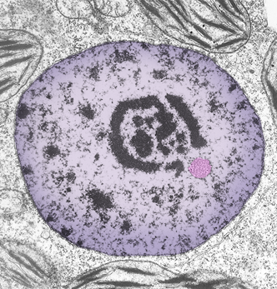
The Nuclear Membrane
Nuclear pores
The nuclear membrane
(or nuclear envelope) is a double membrane, similar to the cell plasma membrane.
It encloses the nucleus to separate its contents from the
cell cytoplasm.
The nuclear membrane has many holes in it called nuclear pores.
  The nuclear pores allow
  the selective passage of materials between the nucleus and the cytoplasm.
  This includes the movement of mRNA into the cytoplasm.
Outer membrane layer
Inner
membrane layer
Cell cytoplasm
Nuclear pores

Slide 5
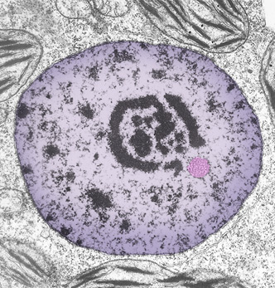
The Nucleolus
The nucleolus is prominent within the nucleus.
It is made up of protein and ribosomal DNA (rDNA).
It has no membrane.
It is the site of RNA transcription and
processing,and ribosome assembly.
Some cell types and organisms
(e.g. Paramecium) contain more than one nucleolus.
Nucleolus
Nucleolus
This image of a cell nucleus (left) was taken using TEM. No membrane separates the nucleolus from the nucleoplasm.
Nucleoplasm

Slide 6
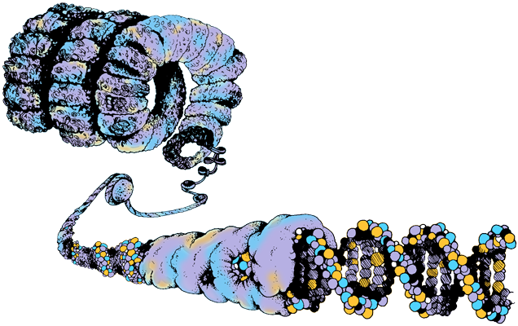
The Genetic Material
The genetic material of eukaryotic cells is deoxyribonucleic acid (DNA).
When cells are not dividing, the chromosomal DNA
is dispersed within the nucleus as fiber-like chromatin.
Chromatin is made up of:
  a cell’s DNA
  proteins (mainly histone)
Chromatin is packed in a way
that allows a large amount of
genetic material to be organized
in a compact way in the nucleus.
  If the DNA from one human
  cell was stretched out it would
  stretch to approximately 1 m long.
DNA
Histone protein
Chromatin: DNA molecules wrapped around histone protein.

Slide 7

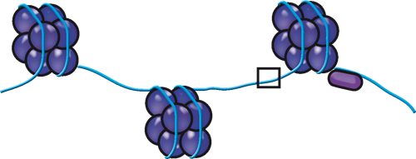
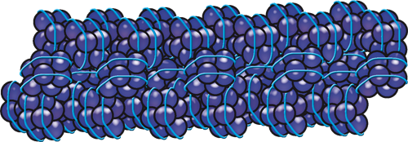
DNA Packing
2 nm
Chromatin structure is based on successive levels of DNA packing. Packing is the role of histone proteins.
Five types of histone proteins form a complex with DNA, resembling “beads on a string.”
  These beads, or nucleosomes, form
  the basic unit of DNA packing.
  The nucleosome bead consists of DNA wrapped around a protein core: two molecules of each of four types of histone (H2A, H2B, H3, and H4).
  A fifth histone, H1, attaches near the bead and organizes the next level of packing.
Histone H1 helps the beaded string to to coil to form a fiber roughly 30 nm thick.
DNA double helix
DNA
10 nm
Nucleosome
H1
Nucleosomes
30 nm
30 nm chromatin fiber

Slide 8
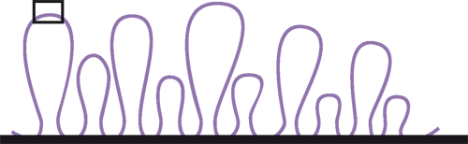
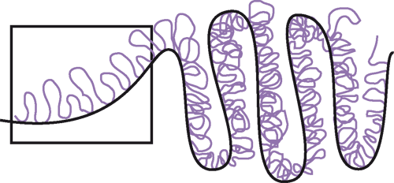
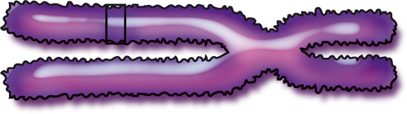
DNA Packing
The 30 nm fiber organized by H1 then forms loops called looped domains, which are attached to a chromosome scaffold of non-histone protein.
The evidence for the existence of these looped domains comes from the study of giant lampbrush chromosomes in amphibian oocytes (egg cells).
In a mitotic chromosome, the looped domains coil and fold, making the chromatin even more compact and producing the characteristic metaphase chromosome.
300 nm
Looped domains of the 30 nm fiber
Protein scaffold
700 nm
1400 nm
Metaphase chromosome

Slide 9
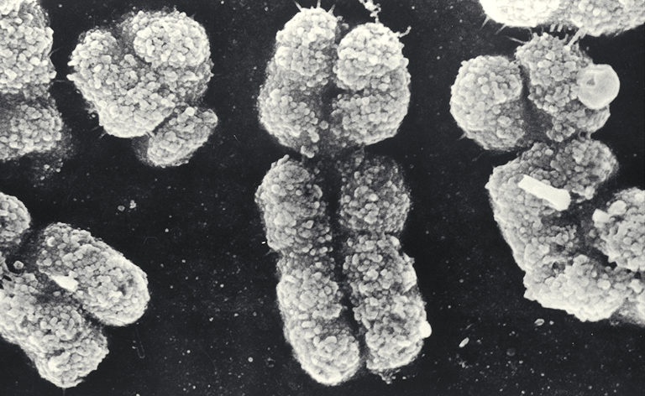
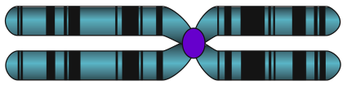
Chromosomes
A visible change in nuclear structure, called chromosome condensation occurs in preparation for cell divsion.
The interphase chromatin, which is already packaged into nucleosomes, condenses approximately 1000X further to form compact chromosomes, which are easily seen using microscopy.
Y
X
Scanning electron microscope (SEM) view of sex chromosomes in the condensed state during a cell division. The smaller chromosome is the ‘Y’ while the larger one is the ‘X’ chromosome.
Diagrammatic representation of a chromosome.

Slide 10

Introduction to DNA
The majority of genetic material in eukaryotic cells is housed within the nucleus.
  Some is also found in the mitochondria, and the chloroplasts of plant cells.
In eukaryotic cells, the genetic material is deoxyribonucleic acid (DNA).
  DNA is packaged as long strands called chromosomes within the nucleus.
DNA is often referred to as the unit of inheritance.
  It provides all the information required for a cell to reproduce and construct a new organism.

Slide 11
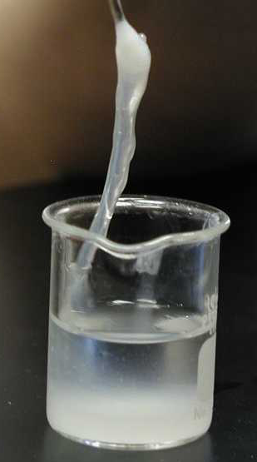
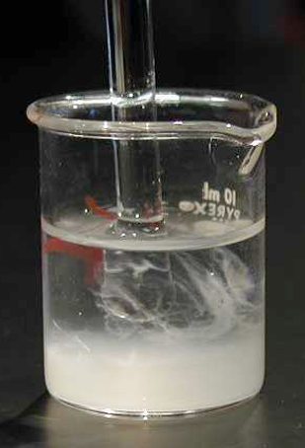
What does DNA Look Like?
DNA can be easily extracted from cells.
Extracted DNA is can be made to form a whitish, glue-like material.
DNA

Slide 12
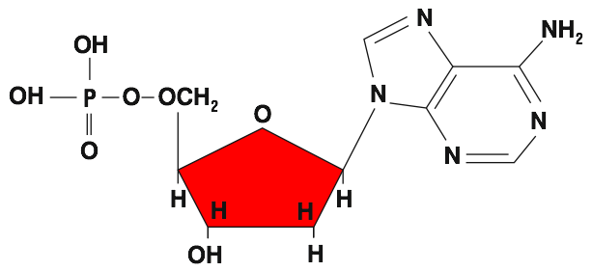
DNA Nucleotides
The DNA molecule is a polymer, made up of many units called nucleotides.
Nucleotide are the building blocks of DNA, and are comprised of the following components:
  a sugar (deoxyribose)
  a phosphate group
  a base (four types possible)
Adenine
Phosphate
Sugar
Base

Slide 13
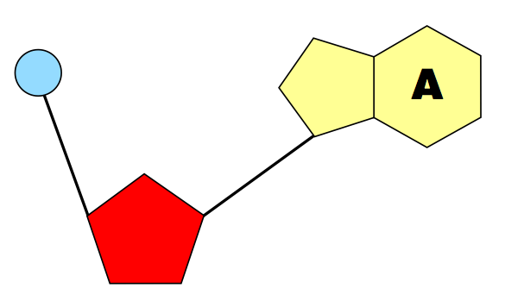
Structure of Nucleotides
Below is the symbolic form of a nucleotide. In this instance it is adenine.
Phosphate:
Links neighboring
sugars
Base:
Four types occur in DNA
• adenine
• guanine
• cytosine
• thymine
Sugar:
deoxyribose in DNA

Slide 14
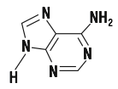

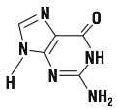





Nucleotide Bases of DNA
The nucleotide bases of DNA form the basis for the cells genetic code.
There are two groups
of nucleotides:
  Purines
  Pyrimidines
Purines
Adenine
Double-ringed structures
Always pair up with pyrimidines
Guanine
Pyrimidines
Cytosine
Single ringed structures
Nucleotide base
Always pair up with purines
Thymine

Slide 15
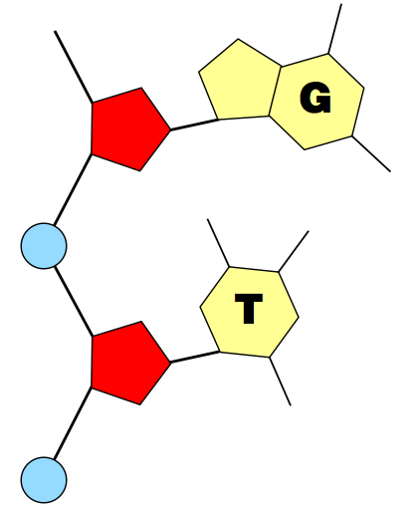
DNA Structure
Phosphates link neighboring nucleotides together to form one half of a double-stranded DNA molecule:
The dinucleotide (left), shows how nucleotides are linked through their phosphate groups to form a chain.
A DNA molecule consists of thousand of nucleotide bases linked together.
Phosphate

Slide 16
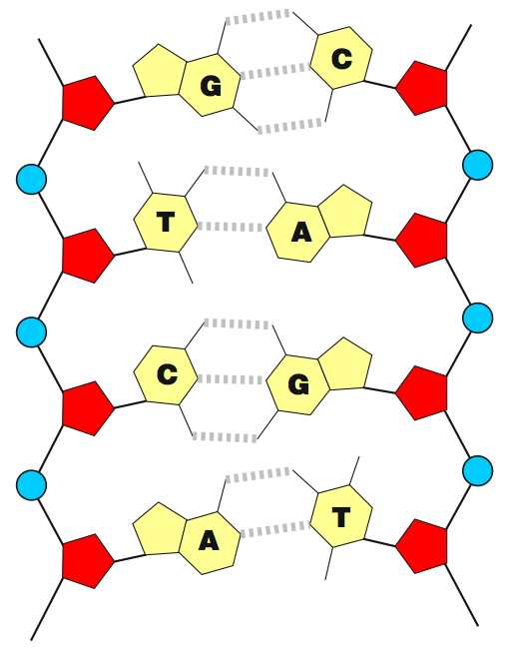
The DNA Molecule
Purines in one DNA strand will always link with pyrimidines in opposing DNA strand.
Hydrogen bonds between the bases form cross-linkages.
This bonding leads to the formation of a double-stranded DNA molecule.
Symbolic representation of a double stranded DNA molecule (right). Note that a double ringed purine will always pair up with a single ringed pyrimidine.
Hydrogen bond

Slide 17
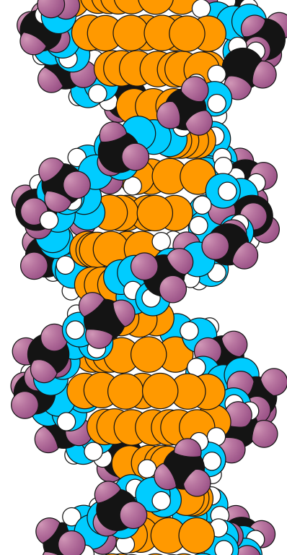
The DNA Molecule
The double-stranded DNA molecule forms a helical shape.
The two chains of nucleotides run in opposing directions and have chemical polarity.
  Because of this, DNA is said to be antiparallel.
DNA backbone
The space-filling model of DNA (right) demonstrates the double helix form that the molecule takes.
The DNA backbone is a polymer with an alternating sugar-phosphate sequence.

Slide 18
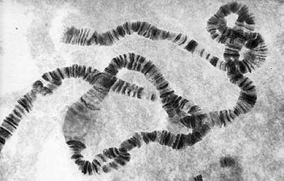
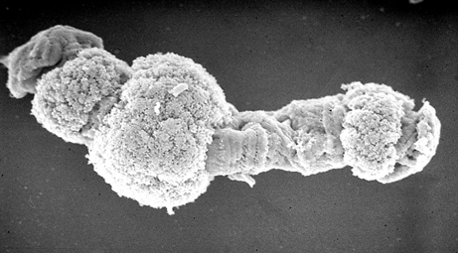
Genes
Within the DNA molecule, the nucleotides form specific coding sequences (genes) which direct a cell to take on a certain form, or perform a certain task.
Each DNA molecule contains thousands of genes.
Genes code for proteins and functional RNA products, but.......
  much of our DNA also constitutes regulatory sequences and promoters.
  Some biologists include these sequences within the definition of a gene.
SEM
The banding on this chromosome is thought to correspond to groups of genes. Regions of chromosome puffing are occur where genes are being transcribed into mRNA.
A polytene chromosome showing localized regions that are uncoiling to expose their genes (puffing) to allow transcription. Polytene chromosomes are giant chromosomes formed by multiple DNA replications.

Slide 19
Size of DNA Molecules
A DNA molecule is very large.
Even the DNA from the small Polyoma virus is 1.7 µm long (3X longer than the longest protein). Comparisons of the sizes of DNA molecules from different organisms are given on the table below.
Sizes of DNA Molecules
Group | Organism | Base pairs (in 1000s or kb) | Length
Viruses | Polyoma or SV40 Lambda phage T2 phage Vaccinia | 5.1 48.6 166.0 190.0 | 1.7 µm 17 µm 56 µm 65 µm
Bacteria | Mycoplasma E.coli | 760 4600 | 260 µm 1.56 mm
Eukaryotes | Yeast (Saccharomyces) Drosophila Human | 13 500 165 000 2 900 000 | 4.6 mm 5.6 cm 99 cm

Slide 20

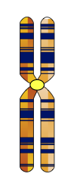
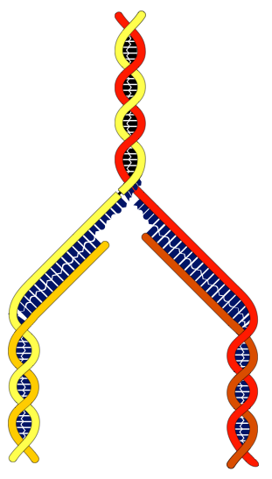

What is DNA Replication?
Parent chromosome
Replicated chromosome
DNA replication (or DNA synthesis) is the process in which DNA is replicated to produce an exact copy of itself.
DNA replication is carried out in preparation for cell division.
Replication is achieved by a single strand of the DNA molecule being used as a template for a new complementary strand.
  The replicated DNA consists of one original strand of DNA, and a newly synthesized strand.
  DNA replication is thus said to be semi-conservative.
Chromatid
Centromere
Parent DNA
G
C
A
T
DNA that will become
separate chromatids

Slide 21
DNA Replication
DNA replication consists of three stages:
1. Unwinding.
The DNA strand is unwound to allow replication to occur.
2. Elongation
A new DNA strand is made using the
original as a template.
3. Termination
DNA synthesis is completed, and the
new DNA molecule assumes its double
helix structure.

Slide 22
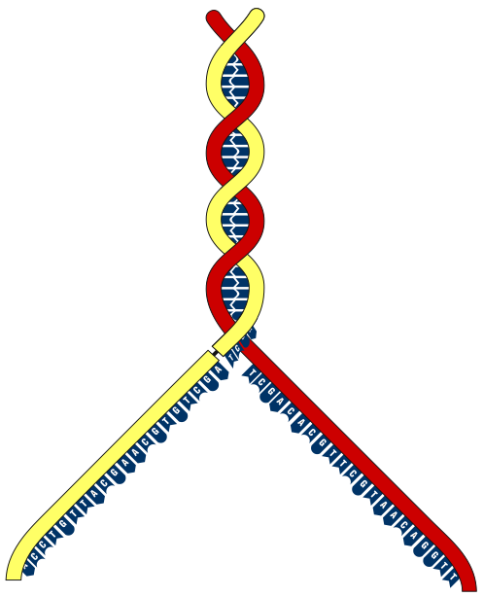

Replication: Unwinding
Single-armed chromosome
as found in non-dividing cell
The coiled DNA is allowed to uncoil by creating a swivel point.
  This opens up the DNA molecule
  for replication.
Two enzymes are involved:
  helicase: unwinds the strands
  DNA gyrase: cuts, winds
  and rejoins the DNA strand.
Temporary break (swivel point)
Replication fork

Slide 23
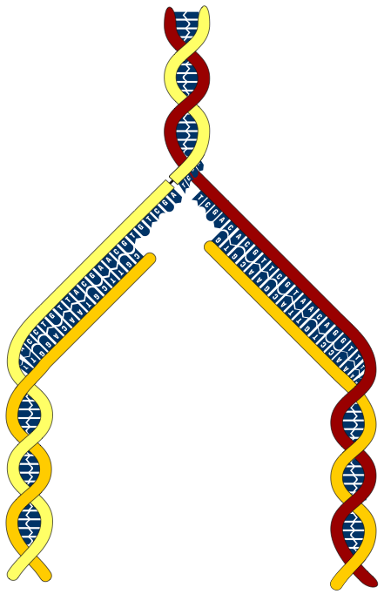
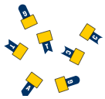

Replication: Elongation
Free nucleotides
are used to construct
the new DNA strand
The unwound DNA strands (parent strands) are used as a template.
New DNA is formed by adding free nucleotides.
The free nucleotides are joined together by the enzyme DNA polymerase.
The new strand is called the daughter strand.
Parent strand of DNA is used as a template.
The new (daughter) strand of DNA.

Slide 24
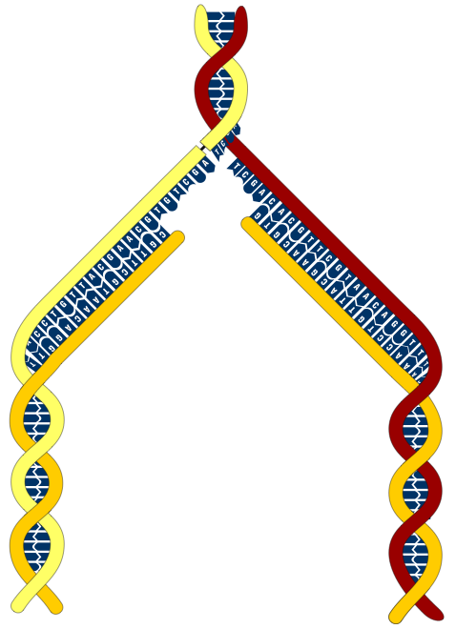

Replication: Termination
The double strands of DNA coil up into a helix
When DNA synthesis is completed, the process is said to be terminated.
Each new DNA molecule contains one strand of original DNA, and one strand of newly synthesized DNA.
The two new strands of DNA coilsup into a helix as a chromosome.
The newly formed chromosome will later split into two chromatids.
Chromosome (2 chromatids)
Parent strand
Daughter strand

Slide 25
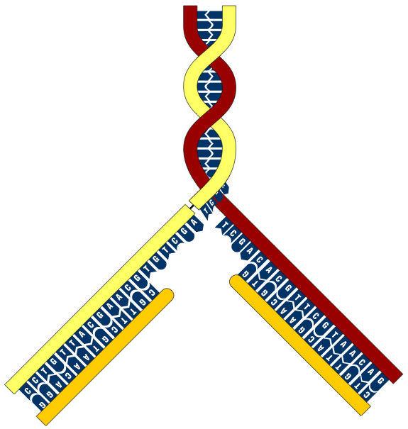
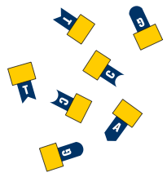

Nucleotide Matching
Free nucleotides are matched with their corresponding template bases following the base pairing rule:
The nucleotides are present as deoxynucleoside triphosphates.
Hydrolysis of these provides the energy for incorporating the nucleotide into the
DNA strand.
A | pairs with | T
T | pairs with | A
G | pairs with | C
C | pairs with | G
Parent strand
Parent strand
Two new daughter strands forming

Slide 26
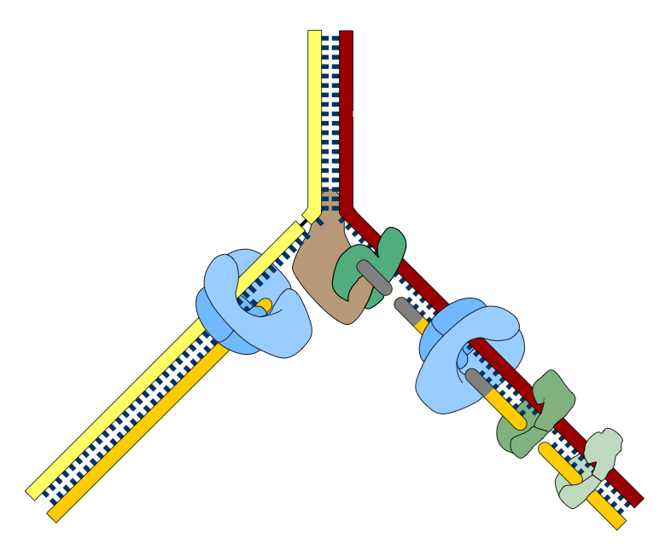
Control of DNA Replication
5'
3'
DNA replication is
highly regulated.
Each stage of replication is controlled by enzymes.
Helicase
RNA polymerase
DNA polymerase III
DNA polymerase III
DNA polymerase I
3'
5'
5'
DNA ligase
3'

Slide 27
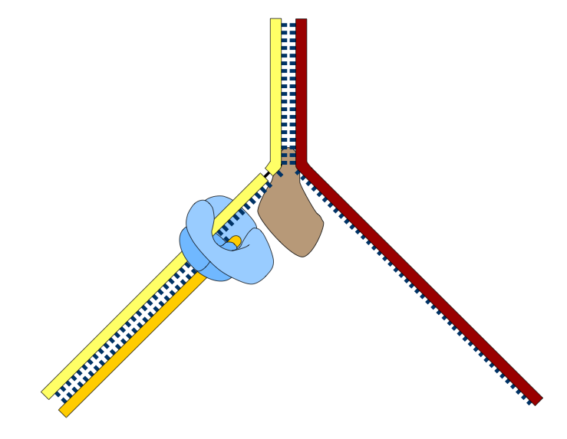
The Leading Strand
Enzymes can build new DNA strands only in the 5’ to 3’ direction.
One strand, the leading strand, is synthesized as a continuous strand.
5'
3'
Overall direction
of replication
Replication fork
DNA polymerase III
The parent strand provides a 'template' for synthesis of the new strand
Helicase splits and unwinds the double-stranded DNA
Direction of synthesis
The leading strand is synthesized continuously in the 5' to 3' direction by DNA polymerase III.
3'
5'
5'

Slide 28
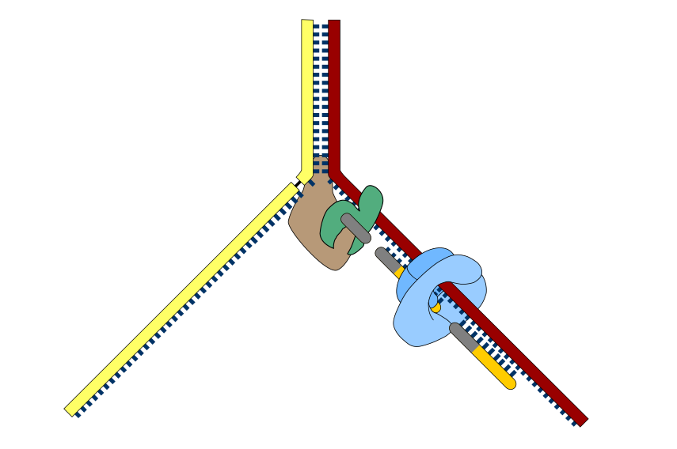
The Lagging Strand
The second new strand, called the lagging strand, is constructed in fragments.
The fragments are later
joined together.
5'
3'
RNA polymerase
Makes a short RNA primer which is later removed.
Overall direction
of replication
DNA polymerase III extends the RNA primer with short lengths of complementary DNA to make Okazaki fragments.
Helicase splits and unwinds the double-stranded DNA
RNA primer
Direction of synthesis
New complementary strand is synthesized discontinuously in fragments 1000-2000 bp long
3'
5'

Slide 29
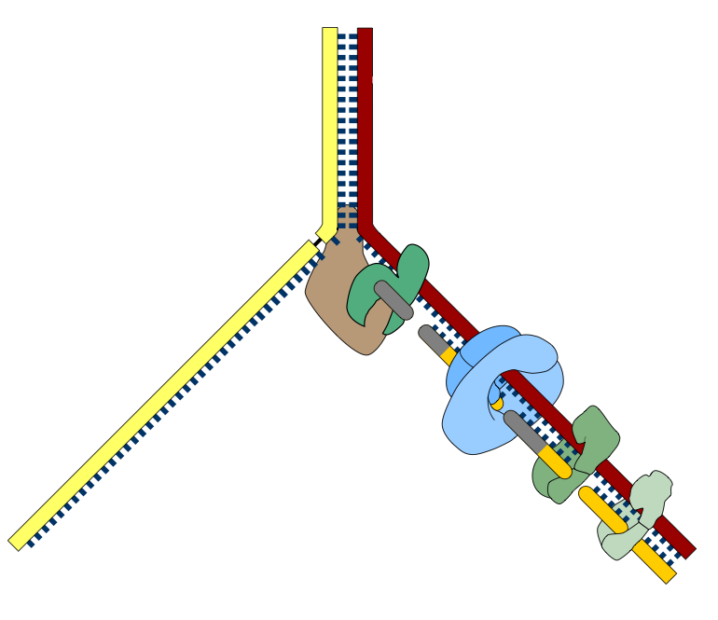
Okazaki Fragments
5'
3'
Overall direction
of replication
DNA polymerase I digests the RNA primer and replaces it with DNA.
DNA ligase joins neighboring fragments together into longer strands.
The lagging strand is formed in fragments (called Okazaki fragments) which are later joined together.
Direction of
synthesis
3'
5'
3'

Slide 30
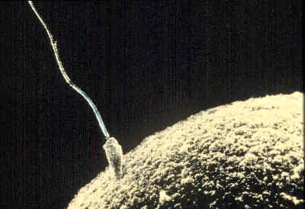
Cell Division
Cell division is the process where a parent cell divides into two daughter cells.
There are two types of cell division:
  Mitosis occurs in somatic cells.
  Meiosis occurs in the sex organs and produces sex cells (gametes).
Ovum (egg)
Sperm
The examination of a root tip of an onion plant (left) shows a proportion of the cells are undergoing mitosis (some indicated with arrows).
Meiosis (meiotic division) produces sex cells or gametes, sperm and ovum (above).

Slide 31
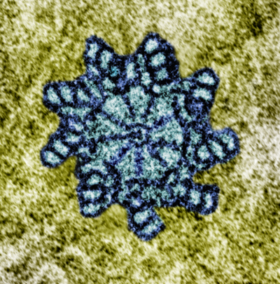

The Centrosome
All eukaryotic cells contain a centrosome,
also called the microtubular organizing center. It has a central role in cell division.
Within an centrosome of animal and algal cells,
there is a pair of centrioles.
During cell division, the centrosome divides and the centrioles replicate, producing two centrosomes, each with its own pair of centrioles.
  The two centrosomes move to opposite ends
  of the nucleus.
  Each centrosome produces microtubules. These form the spindle responsible for separating the replicated chromosomes into two daughter cells.
Plant cells have centrosomes, with a similar role to those in animal cells, but they lack centrioles.
Each centriole (cross section above) is made up of a ring of nine groups of microtubules. There are three fused microtubules in each group. The two centrioles lie at right angles to each other.

Slide 32
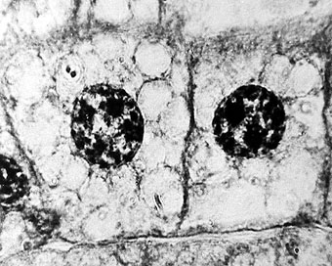
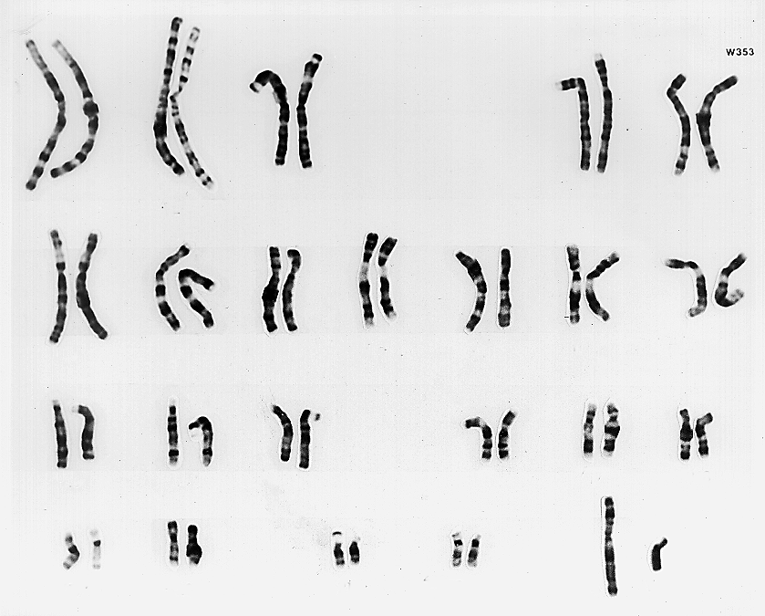
Introduction to Mitosis
During mitosis, an existing parent cell divides into two new daughter cells (right).
The cells are genetically identical.
There is no change in chromosomal number.
  Cells are diploid, containing two sets
  of chromosomes.
  In humans the diploid number is 46
Mitosis is associated with the growth
and repair of somatic cells in the body.
Normal male karyotype
Humans have 23 pairs of chromosomes, 22 pairs of autosomes and 1 pair of sex chromosomes.
The karyotype on the right is for a normal male. The sex chromosomes (XY in this example) are highlighted.

Slide 33
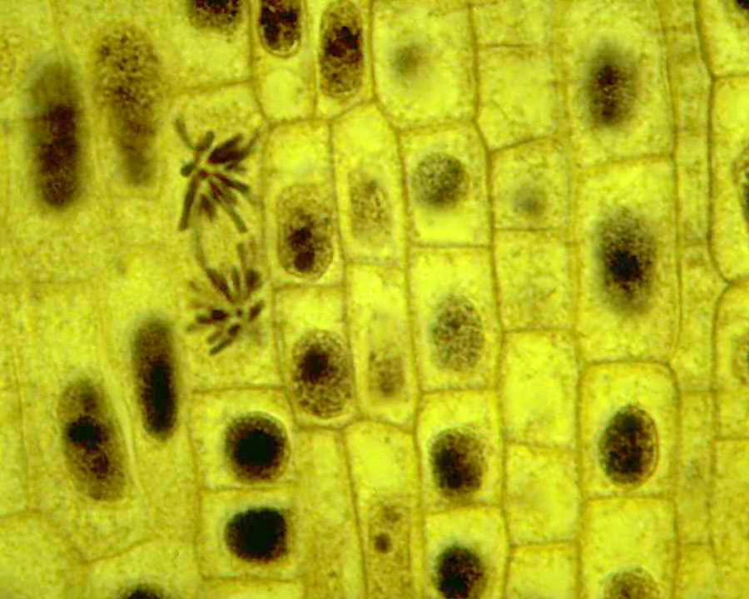
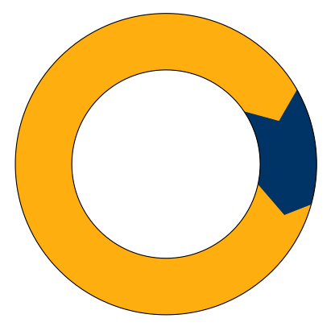
Mitosis and the Cell Cycle
Mitosis is just one phase of the cell cycle.
There are three main phases in the
cell cycle:
  Interphase (itself comprising three stages)
  Mitosis (nuclear division)
  Cytokinesis (division of the cytoplasm)
Interphase
The cells in this section are in various stages of the cell cycle. In a dividing cell, the mitotic phase phase alternates with an interphase, or growth period.
The cell cycle
Mitosis
C
Cytokinesis

Slide 34
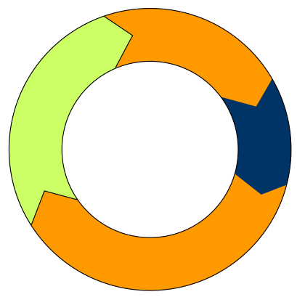

Interphase
G2
Interphase accounts for 90%
of the cell cycle.
  It is the longest phase of the cell cycle.
Interphase consists of three stages:
  First gap phase (G1)
  The cell grows and develops
  Synthesis (S)
  The cell duplicates its genetic
  material (chromosomes).
  Second gap phase (G2)
    The nucleus is well defined
    The chromosomes condense into chromatids in preparation for division
    The centrosome is replicated
S
The cell cycle
M
C
G1
Nucleolus
Centrosome is replicated
Nuclear membrane
Chromatid

Slide 35
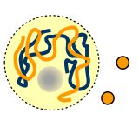
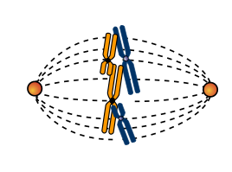
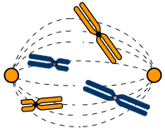
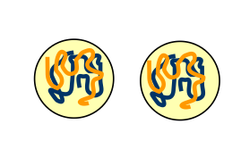
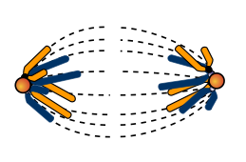

Mitosis
The mitotic cycle is broken down into six phases.
The example below is for a plant cell.
Early Prophase
Late Prophase
Metaphase
Telophase
Late Anaphase
Anaphase

Slide 36

Mitosis: Early Prophase
Nuclear membrane disintegrates
Prophase is the first stage of mitosis. In early prophase:
  the nuclear membrane disintegrates
  the nucleolus disappears
  the chromatin condenses into visible chromosomes.
Replicated centrosomes
Nucleolus disappears
Nuclear membrane
The chromatids condense into chromosomes

Slide 37

Mitosis: Prophase
Centromere and kinetochore
Centrosome
In late prophase:
  the chromosomes continue to coil
  and appear as double chromatids.
  the chromatids are each joined by a centromere.
  the centrosomes move to opposite poles (ends) of the cell. As they do so, they form the mitotic spindle between the poles.
  the kinetochores mature and attach to the spindle.
Chromatids
A newt lung cell in late prophase (stained with fluorescent dyes). The mitotic spindles appear green and the nucleus appears blue.

Slide 38

Mitosis: Metaphase
During metaphase the chromosomes become aligned at the equator of the cell.
Kinetochores attach the chromosomes to the spindle and align them along
the metaphase plate at the equator of
the cell.
  The metaphase plate is an imaginary
  plane equidistant between the two poles.
  Kinetochores are disc like structures to which the spindle fibers attach.
  The spindle fibers are made up of microtubules and associated proteins,
  joined at the ends (the spindle poles).
  Some spindle fibers extend to the equator but do not attach to chromosomes.
Mitotic spindle
Chromosomes

Slide 39


Mitosis: Early Anaphase
In anaphase, the chromosomes are pulled to opposite poles of the cell.
  the centromeres divide, freeing the two sister chromatids from each other.
  Each chromatid is now considered to be a chromosome.
  The spindle fibers begin moving the once-joined sisters to opposite poles of the cell.
Chromosomes
Spindle
Anaphase is the shortest mitotic phase

Slide 40

Mitosis: Late Anaphase
By late anaphase, the chromosomes have moved to opposite poles.
  The kinetochore microtubules shorten as the chromosomes approach the poles.
  At the same time, non-kinetochore microtubules elongate the cell
  (i.e. move the poles apart).
By the end of anaphase, the two poles of the cell have equivalent, and complete, collections of chromosomes.
Centrosome
Mitotic spindle
Chromosomes

Slide 41

Mitosis: Telophase
Telophase is characterized by the formation of two new nuclei.
  The non-kinetochore microtubules continue to elongate the cell.
  The daughter nuclei begin to form at the two poles of the cell where the chromosomes have gathered.
  The nucleoli reappear and the chromatin becomes less tightly coiled (less condenses).
In plant cells, the cell plate forms where the new cell wall will form.

Slide 42
Cytokinesis
Cell wall
The division of the cytoplasm is termed cytokinesis.
Cytokinesis is usually well underway by the end of telophase, so that the appearance of two new daughter cells follows shortly after the end of mitosis.
  In plant cells, the cell plate forms where the new cell wall will form.
  In animal cells, a cleavage furrow pinches the cell in two.
The two daughter cells are now separate cells in their own right.
Two cells are formed
Nucleus

Slide 43
Mitosis: Review
Interphase
Early Prophase
Late Prophase
Cell enters mitosis
DNA replicated.
DNA continues condensing.
Chromosomes appear as chromatids.
Metaphase
Centrosome replicated.
Nuclear membrane disintegrates.
Mitotic spindle forms.
Nucleus still well defined.
Nucleolus disintegrates.
Centrosomes move to opposite poles.
Chromosomes line up on the metaphase plate.
Cytokinesis
Telophase
Late Anaphase
Anaphase
Nuclei reform.
Non-kinetochore microtubules elongate the cell.
Chromosomes separate to opposite poles.
Two independent cells.
Cell plate forms (plants)

Slide 44

Mitosis in the Root Tip
Zone of specialization
Mitosis in plant cells occurs only in regions of meristematic tissue.
The meristematic tissue is located at the tip of every stem and every root.
In contrast, mitosis can occur throughout the body of a growing animal.
Root tip growing in this direction
Zone of elongation
Meristematic tissue (area of cell division)
Zone of cell division
Root cap

Slide 45



Introduction to Meiosis
The purpose of meiosis is to produce haploid sex cells (gametes).
  They have one copy of each homologous pair of autosomes plus one
  sex chromosome.
  In humans the haploid number is 23.
  A haploid cell is achieved because the chromosomes are replicated once, but the cell undergoes two divisions.
Meiosis only occurs only in the ovaries and testes.
Developing sperm
Oogenesis in Rana ovary
Sperm surround an egg prior to fertilization
Spermatogenesis

Slide 46














Meiosis
Crossing over may occur at this stage in meiosis
2N
2N
Like mitosis, meiosis is
preceded by DNA replication.
Meiosis comprises two divisions:
  Meiosis I: This first division separates the homologous chromosomes into two intermediate cells.
  Meiosis II: Effectively a
  mitotic division, but the
  number of chromosomes remains the same because they are not duplicated a second time.
The chromosomal number is halved (1N) during meiosis I, and remains so throughout meiosis II.
First Division
(reduction division)
2N
1N
Intermediate cell
Intermediate cell
Second Division
('mitotic' division)
1N
1N
Gametes
(eggs or sperm)

Slide 47

Meiosis I
Interphase
DNA replication
2N
The first division of meiosis is called a ‘reduction’ division because it halves the number of chromosomes.
One chromosome from each homologous pair is donated to each intermediate cell.
  In prophase 1, homologues pair up to form bivalents in a process called synapsis. The arms may become entangled and genetic material can be exchanged.
  Anaphase 1 separates homologues.
Prophase 1
Synapsis and crossing over
2N
Bivalents line up on the equator of the cell.
Metaphase 1
2N
Anaphase 1
Telophase 1
1N
Intermediate cell
Intermediate cell
Homologues separate

Slide 48

Meiosis II
This diagram shows only half the full chromosome complement
1N
The second division of meiosis is called a ‘mitotic’ division, because it is similar
to mitosis.
There is no chromosome duplication in meiosis II.
Sister chomatids (now separate chromosomes) are pulled apart and are donated to each gamete cell.
The gametes are haploid (1N).
Intermediate cell
Prophase 2
1N
Metaphase 2
1N
Anaphase 2
Telophase 2
1N
Gamete
(egg or sperm)
Individual chromosomes separate

Slide 49








Cell Division: An Overview
Male
adult
A single set of chromosomes
Male
embryo
Sperm
Many mitotic
divisions
Meiosis
A double set of chromosomes
2N
2N
1N
Fertilization
Many mitotic
divisions
Many mitotic
divisions
Somatic cell production
Gamete production
Zygote
2N
Embryo
Adult
2N
2N
Somatic cell production
Somatic cell production
Many mitotic
divisions
Female
embryo
Female
adult
Meiosis
Egg
2N
2N
1N

Slide 50



Non-Disjunction in Meiosis
Chromosomes can fail to separate
during meiosis.
  This is called non-disjunction.
  It results in abnormal numbers of chromosomes in the gametes.
Non-disjunction can occur:
  if chromosomes fail to separate at anaphase I.
  if sister chromatids fail to separate during anaphase II.
Fertilization of an abnormal gamete with a normal gamete (or vice versa) results in an abnormal chromosome number.
  This is known as an aneuploidy, e.g. trisomies occur where there are three instead of the normal pair of a chromosome (right).
Photos: Cytogenetics Dept. Waikato Hospital
Trisomy 13
Trisomy 18
Trisomy 21

Slide 51





Non-disjunction in Meiosis I
Incorrect separation of chromosomes results in uneven distribution of chromosomes.
Meiosis I
This example shows
non-disjunction in meiosis I; homologous chromosomes fail
to separate properly at anaphase during meiosis I.
Meiosis II
Note the uneven distribution of chromosomes in the gametes at the completion of meiosis.
n+1
n+1
n–1
n–1
Non-disjunction in Meiosis I

Slide 52





Non-disjunction in Meiosis II
Meiosis I
Normal separation of chromosomes occurs during meiosis I.
Meiosis II
Sister chromatids fail to separate during meiosis II. The result is an uneven distribution of gametes.
Non-disjunction can also occur in meiosis II, when sister chromatids fail to separate during anaphase of meiosis II.
n+1
n–1
n
n
Non-disjunction in Meiosis II

Slide 53


Aneuploidy
If aberrant gametes formed from non-disjunction unite with a normal gamete at fertilization, the offspring will have an abnormal chromosome number.
  There can be too many chromosomes (2N+1)
  There can be too few chromosomes (2N-1)
These chromosomal defects
are known as aneuploidy.
XY
XX
XY
X
X
XY
XY
X
X
X
X
Aneuploidy of sex chromosomes can arise from faulty egg production or faulty sperm production (right). This example shows the results of non-disjunction in the male, where the sex chromosomes failed to separate during meiosis.
XXY
XO
XXY
XO

Slide 54

Aneuploidy in Sex Chromosomes
Aneuploidy can result in an abnormal number of sex chromosomes.
Turner syndrome affects females.
  There is only one sex chromosome (X), the other is missing.
Klinefelter syndrome affects males and they have at least one additional sex chromosome.
  There are at least two X chromosomes and one Y chromosome.
Turner Syndrome karyotype
The karyotype above shows Turner syndrome, there is only one X chromosome present. Women with Turner syndrome have rudimentary ovaries, short stature, a webbed neck and a broad chest.

Slide 55

Aneuploidy in Autosomes
Down Syndrome karyotype
Aneuploidy can also affect autosomes (non-sex chromosomes).
In trisomy, the nucleus of the cells have one extra chromosome (2N+1).
The affects can be so severe that it results in spontaneous loss of the fetus.
Three forms of trisomy survive to birth:
  Down syndrome (trisosmy 21)
  Edward syndrome (trisomy 18)
  Patau syndrome (trisomy 13)
This is the karyotype of a male with Down syndrome. Down syndrome is characterized by three autosomes (trisomy) at chromosome 21.

Slide 56


Apoptosis
Apoptosis or programmed cell death (PCD) has many crucial roles in the body, including:
  maintenance of adult cell numbers. In humans, 50-70 billion cells undergo apoptosis each day to make way for new cells.
  defense against damaged or dangerous cells, such as:
    virus-infected cells
    cells with DNA damage
  the transformation and “sculpting” of embryonic tissue during its development:
    formation of fingers and toes in a fetus
    sloughing of the endometrium during menstruation
    formation of proper connections (synapses) between neurons in the brain
A normal leukocyte (top) and one undergoing apoptosis (bottom). Note the bulbous appearance of the membrane. This is called blebbing.

Slide 57






The Process of Apoptosis
As series of morphological changes occur when a cell undergoes apoptosis.
1
2
3
The cell shrinks and loses contact with neighboring cells. The chromatin condenses and begins to degrade.
Nuclear membrane degrades. Cell loses volume. The chromatin clumps into chromatin bodies.
Zeiosis: The plasma membrane forms bubble like blebs on its surface.
Membrane-bound apoptotic bodies
4
5
6
No spilling of contents
The nucleus collapses, but many membrane-bound organelles are unaffected.
The nucleus breaks up into spheres and the DNA breaks up into small fragments.
The cell breaks into apoptotic bodies, which are quickly resorbed by phagocytosis.

Slide 58


Control of Apoptosis
Apoptosis is a complicated and tightly controlled process, distinct from cell necrosis (uncontrolled cell death), when the cell contents are spilled.
Regulation occurs through a combination of:
  positive signals, required for cell survival.
  negative signals, triggering cell death.
When these are unbalanced one of two things may occur:
  The rate of apoptosis becomes too high, e.g. HIV infected helper T-cells induce apoptosis in neighboring T-cells, limiting the immune response to the virus.
  The rate of apoptosis becomes too low,
  e.g. a low rate of lymphocyte apoptosis
  is associated with an overactive
  immune system.
Wikipedia Commons http://commons.wikimedia.org/wiki/Image:Celldeath.jpg
Incomplete differentiation of the toes (syndactyly) as a result of lack of apoptosis.
Laboratory of Experimental Pathology, Division of Intramural Research, NIEHS (NIH)
Apoptosis in mouse liver showing the apoptotic cells (stained orange).

Slide 59

Controls of Apoptosis
Negative signals for inducing apoptosis are those that trigger the cellular changes leading to cell death. They include:
  Intrinsic inducer signals generated from within the cell in response to stress, e.g. DNA damage, starvation, or reactive oxygen.
  Extrinsic inducer signals or death activators, which promote apoptosis, e.g. certain
  cytokines (signaling proteins and peptides)
  such as lymphotoxin.
Positive signals prevent apoptosis and allow a cell to function normally. They include:
  interleukin-2 and bcl-2 protein
  certain cytokines and growth factors
  inhibitors of apoptosis proteins
Interleukin-2 is a postive signal for cell survival. Like other cell signaling molecules (ligands) it binds to surface receptors on the cell to regulate cell metabolism. Most signaling molecules (both negative and positive) are peptides or proteins

Slide 60

Apoptosis and Cancer
Cancer tissue
Breast tissue
Cell proliferation and death are controlled by two gene families:
  Proto-oncogenes, which promote cell growth.
  Tumor suppressor genes, which inhibit cell growth.
Mutations to (or bypassing of) these genes gives rise to uncontrolled cell division and results in the formation of immortal cancer cells.
Cancer tissue (pale yellow) is clearly obvious in the mastectomy specimen of breast tissue (dark yellow) above.

Slide 61

Apoptosis and Cancer
Cancer tissue
Kidney tissue
Cancer cells can divide rapidly and spread because they are able to prevent apoptosis.
  Human papilloma virus (HPV), which is linked to cervical cancer, is able to inactivate an apoptosis promoter and continue to spread.
  Other cancer cells express high levels of proteins, such as bcl-2, which suppress apoptosis and allow the cell to divide rapidly
  and form tumors.
CDC
Cancer in a bisected kidney. Most of the kidney has been replaced by gray and yellow tumor tissue. Only a small amount of healthy kidney tissue still present

Slide 62

Features of a Cancer Cell
Cancer cells do not differentiate into a specialist cell type.
A cancer cell is parasitic, taking nutrients from surrounding cells by forming large numbers of blood vessels to supply it.
A cancer cell undergoes uncontrolled division, which is not inhibited by contact with surrounding cells.
Cancer cells can be motile, enabling them to spread (metastasize) around the body.
There may be an unusual number of chromosomes.
Cancer cells have a bloated, lumpy shape.
Cancer cells lose their attachment to neighboring cells.

Slide 63

Inducing Apoptosis in Cancer Cells
Understanding how apoptosis is controlled can help researchers find ways to treat cancer (e.g. by inducing cancer cells to undergo apoptosis).
Several apoptosis-inducing drugs are being developed.
  Some suppress the production of anti-apopotic proteins such as bcl-2. If levels of bcl-2 decrease sufficiently, apoptosis will occur.
  Other drugs are designed to be used with existing cancer treatments such
  as chemotherapy.
Chemotherapy being administered to a cancer patient. Chemotherapy targets actively dividing cells, which includes some types of cancer cells.

Slide 64


Apoptosis and Limb Development
Apoptosis is important for the normal development of animal embryos.
  Apoptosis removes unnecessary tissue and sculpts the embryo.
A good example is the formation of the fingers and toes in the human fetus.
  41 days after fertilization (top right), the digits of the hands and feet are webbed, making them look like small paddles.
  The webbing is superfluous, and is removed by apoptosis. By 56 days after fertilization, the webbing has completely disappeared and each of the digits can be individually seen (right).

Slide 65


Slide 66
Terms of Use
Biozone International retains copyright to the intellectual property included in this presentation file, with acknowledgement that certain photos are used under license and are credited appropriately on the next screen.
You MAY:
  Use these slides for presentations in your classrooms using a data projector, interactive whiteboard, and overhead projector.
  Place these files on the school’s intranet (school computer network), but not in contradiction of clause 3 (a) below.
  Edit and customize this file by adding, deleting, and modifying information to better suit your needs.
  Place these presentation files on any computer within the school, including staff laptops.
  Print out this file in PowerPoint “Handouts” format as per the print dialogue box, for the express purpose of allowing students to make their own notes about the presentation.
You MAY NOT:
  Put these presentation files onto the internet or on a service that may be accessed offsite from the campus, unless access to the service is protected by a user login and password protocol.
  Print these files onto paper to make your own worksheets for distribution to students.
  Create a NEW document using any of the graphics/images in this presentation file.
  Incorporate any part of this presentation file for the production of another commercial product.
  REMOVE any of the references to Biozone, the copyright notices, photo credits, or terms of use from this file.

Slide 67
Photo Credits
Images Used Under Licence
Photographic images are used under licence from the following photo libraries:
  Corel Corporation Professional Photos
  (various titles, including: Science & Medicine, Agriculture).
  ArtToday.com
  Clipart.com
  PhotoDisc Inc.
  Hemera Technologies Inc.
  PhotoObjects.com
  Visuals Unlimited
  iStock
  Education Interactive Imaging
Images Used with Permission
Photographic images used with permission from the copyright holder:
Center for Biomolecular Modeling Milwaukee school of Engineering
Cytogenetics Department
Waikato Hospital
Images from the Public Domain
Images from the public domain include copyright expired, uncopyrighted, or uncopyrightable material:
CDC Public Health Image Library (PHIL)
pschemp; http://commons.wikimedia.org/wiki/Image:Celldeath.jpg
Laboratory of Experimental Pathology, Division of Intramural Research, NIEHS (NIH)
Additional artwork and photographs are the property of Biozone International Ltd.
BIOZONE International Ltd | P.O. Box 13-034, 109 Cambridge Road, Hamilton, NEW ZEALAND
Phone: + 64 7 856-8104 | Fax: + 64 7 856-9243 | E-mail: sales@biozone.co.nz | Internet: www.biozone.co.nz
Copyright © 2007 Biozone International Ltd
All rights reserved

Slide 68






Presentation MEDIA
Our current range includes:
See full details on our web site:
www.thebiozone.com/media.html

